Slide 1
Module 10 Guided Lab - Automating Infrastructure Deployment with AWS CloudFormation
Made for Professor Lanham A. by Amrit Singh

Slide 2
AGENDA
Accessing the AWS management console
Task 1 : Deploying a networking layer
Task 2: Deploying an application layer
Task 3: Updating a Stack
Task 4: Exploring templates with AWS CloudFormation Designer
Task 5: Deleting the stack

Slide 3
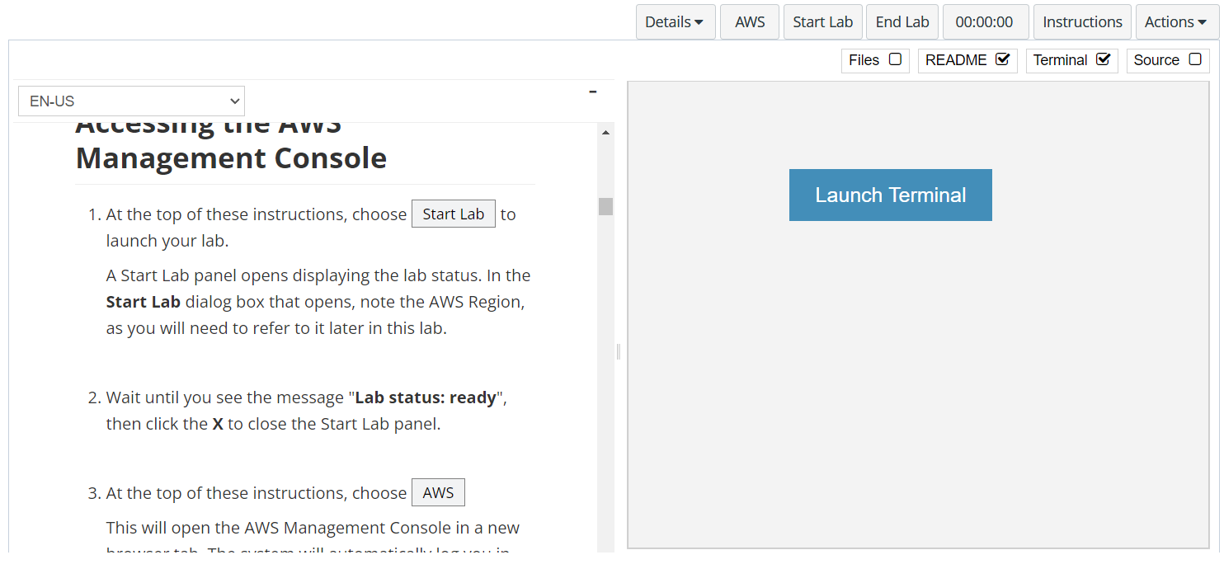
In aws labs click on start lab

Slide 4
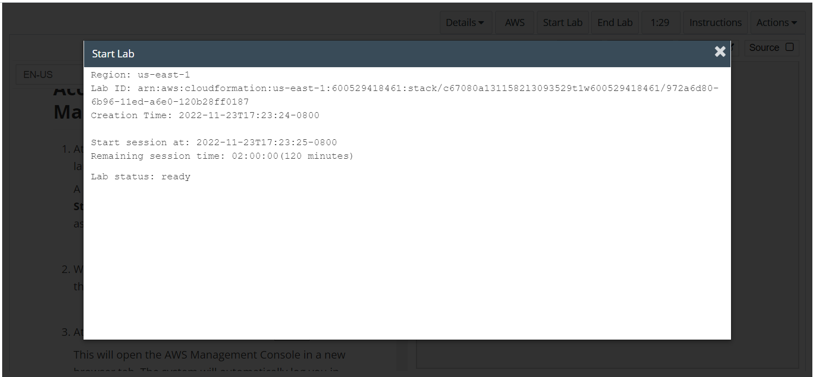
Wait to see lab ready status in the window then press x and click on aws to launch console

Slide 5
Task 1 : Deploying a networking layer

Slide 6
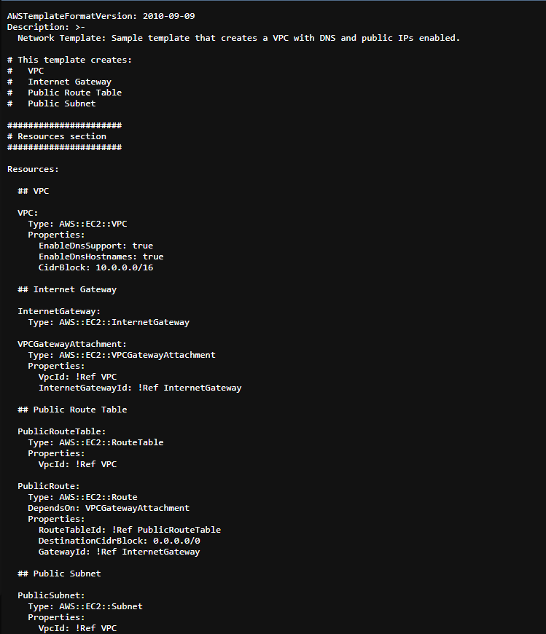
Save and download the lab-network.yaml from aws labs

Slide 7
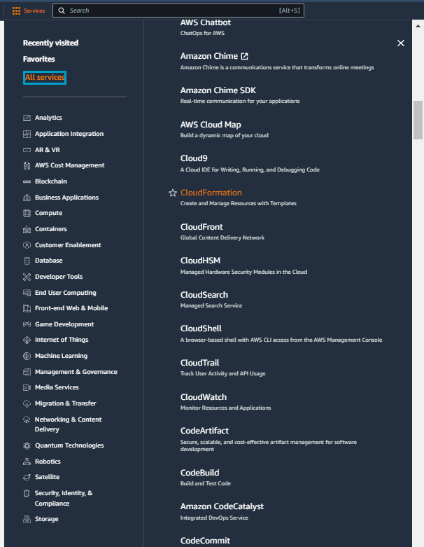
Select services and then click on Cloudformation button
Click on the Services button
Click on the CloudFormation button

Slide 8
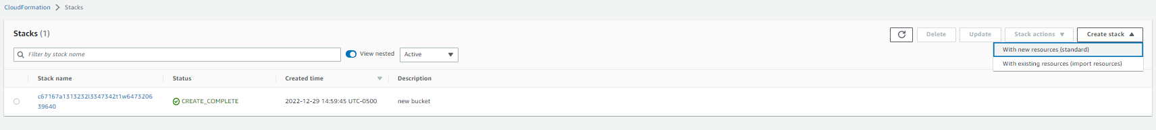
On the cloudformation page click on create stack and choose with new resources

Slide 9
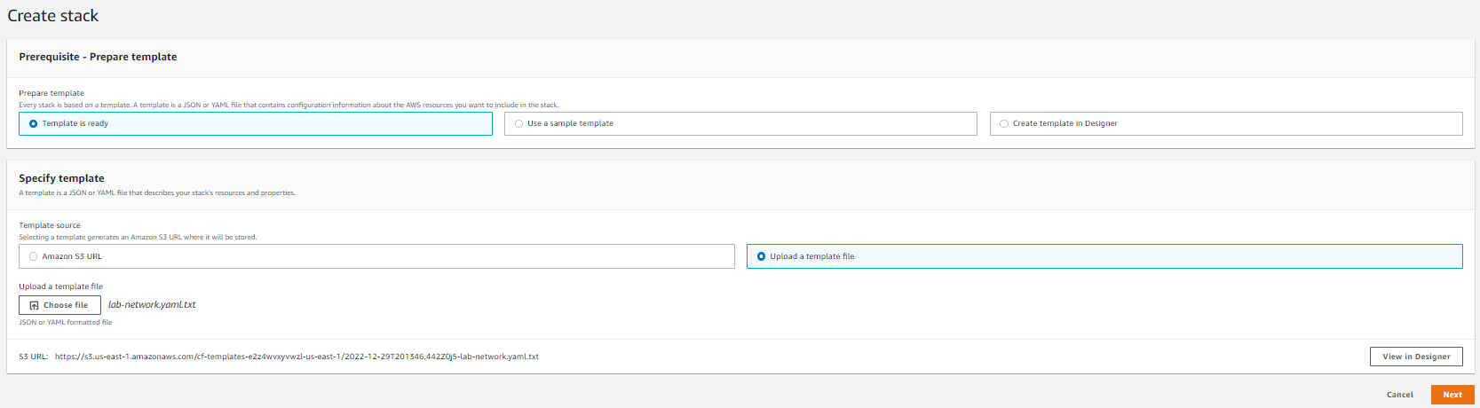
Under create stack choose upload a template file and then upload lab-network.yaml.txt

Slide 10
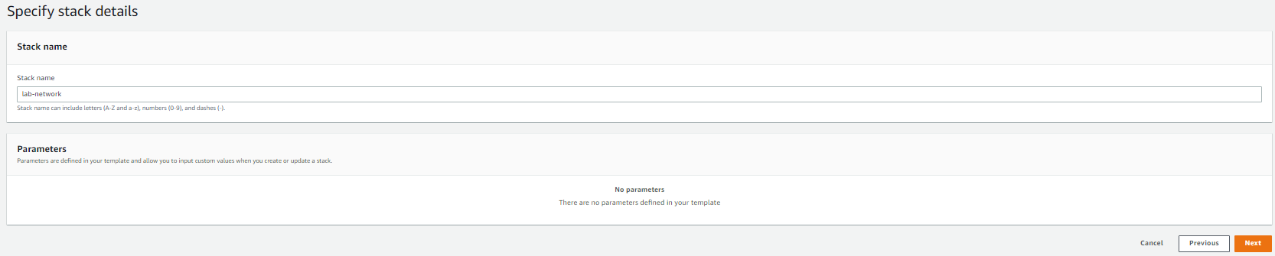
Specify the name in the specify stack details and click next

Slide 11
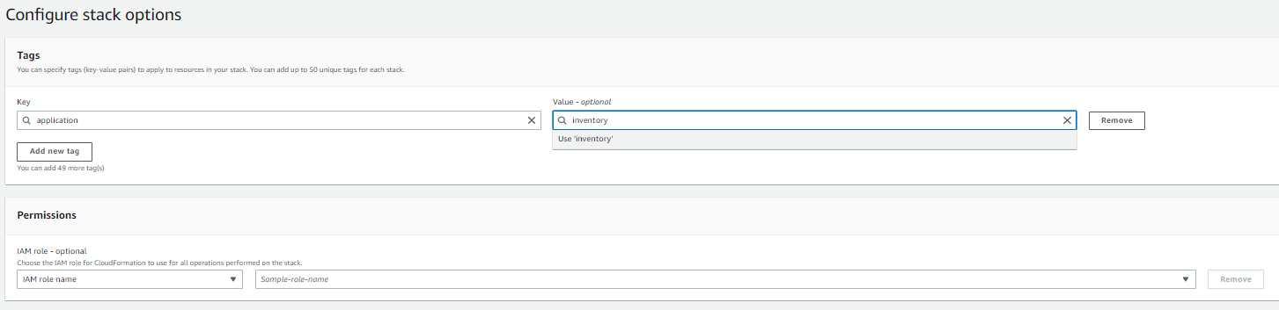
Specify the tags as mentioned in the labs and click next

Slide 12
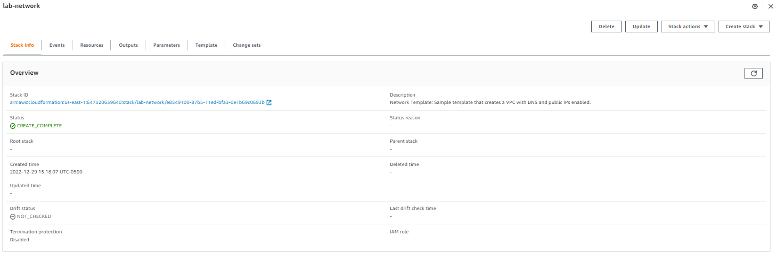
Under stack info wait for the status to change to create_complete

Slide 13
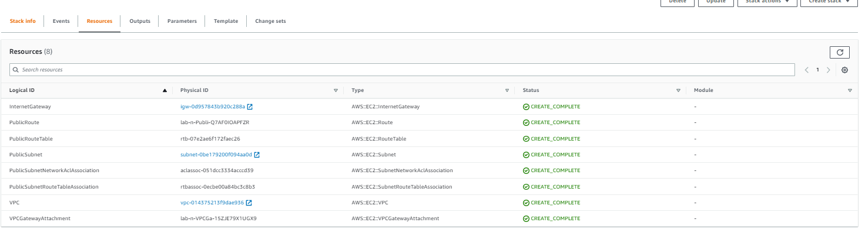
Move to resources tab to view the created resources

Slide 14
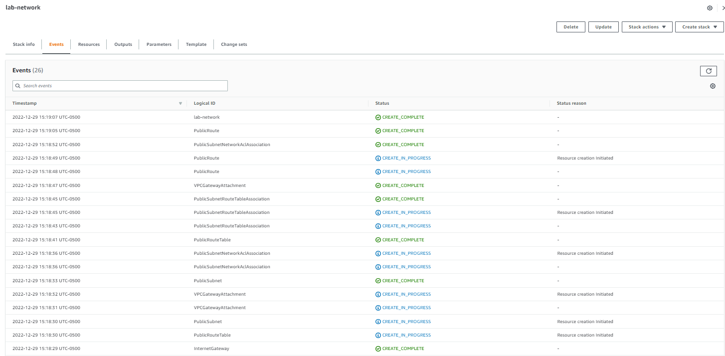
Go to events tab to view the log information

Slide 15
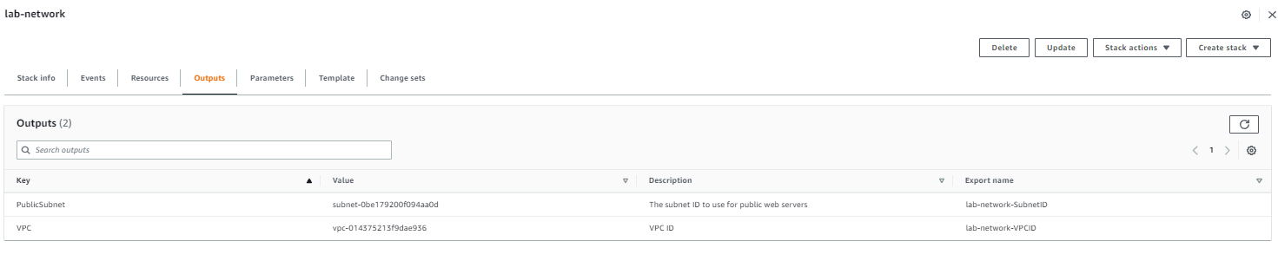
Under the outputs tab you can view the export name for keys

Slide 16
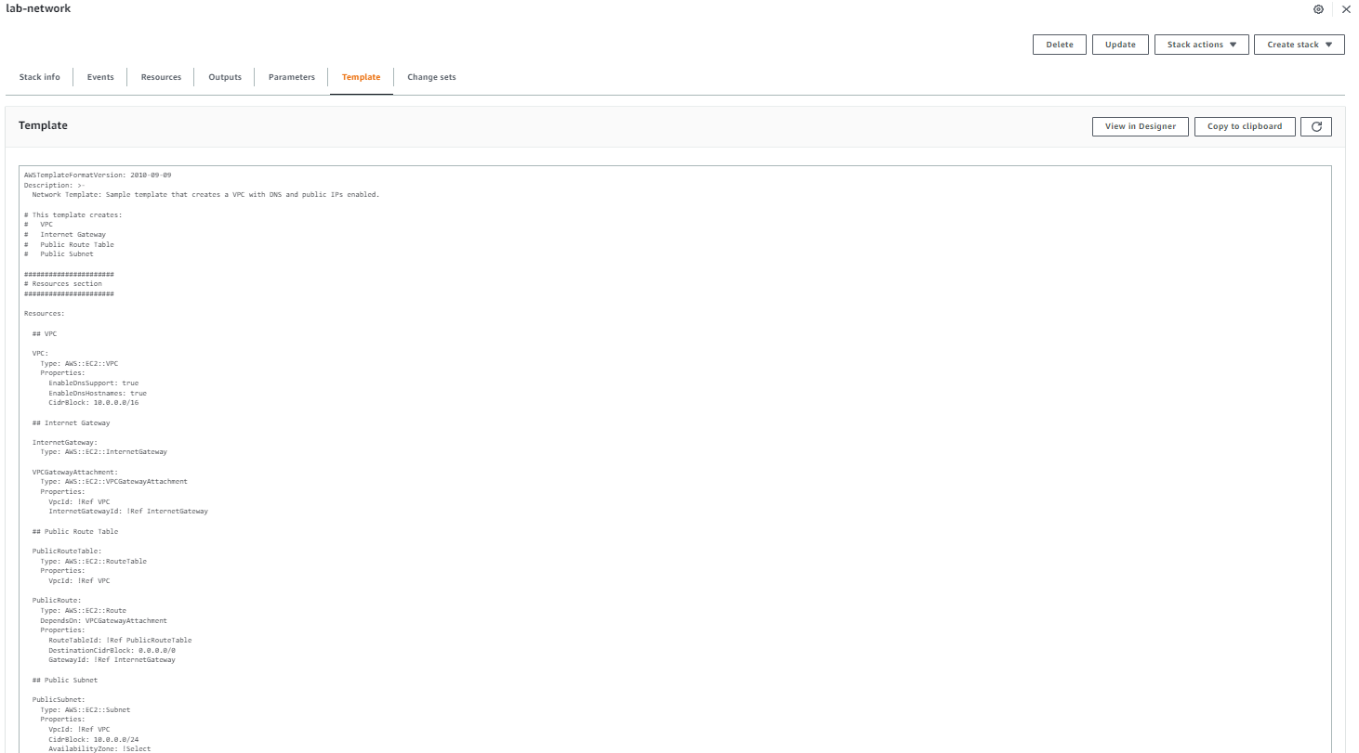
Template tab has the relevant information leveraged for creating the stacks

Slide 17
Task 2 : Deploying an application layer

Slide 18
Save and download the lab-application.yaml from aws labs

Slide 19
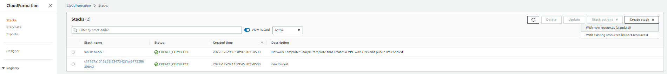
Go to stacks in the navigation pane and click on create stack > with new resources (standard)

Slide 20
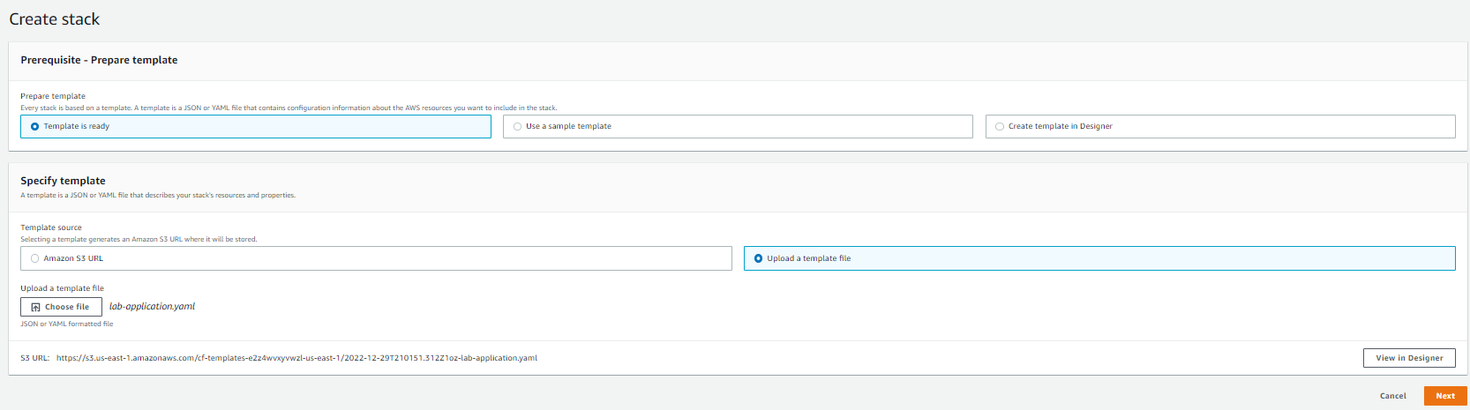
Upload the lab-application.yaml file under upload a template file

Slide 21
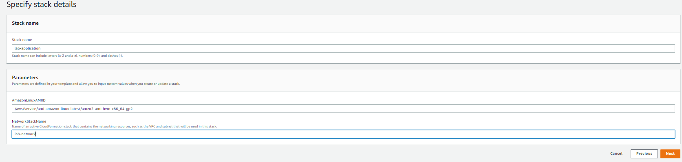
Specify the name in the specify stack details and click next

Slide 22
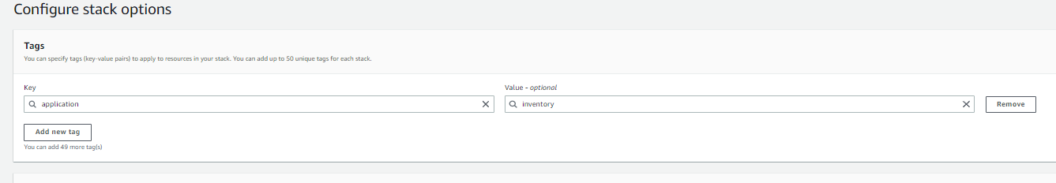
Specify the tags as mentioned in the labs and click next and then click submit

Slide 23
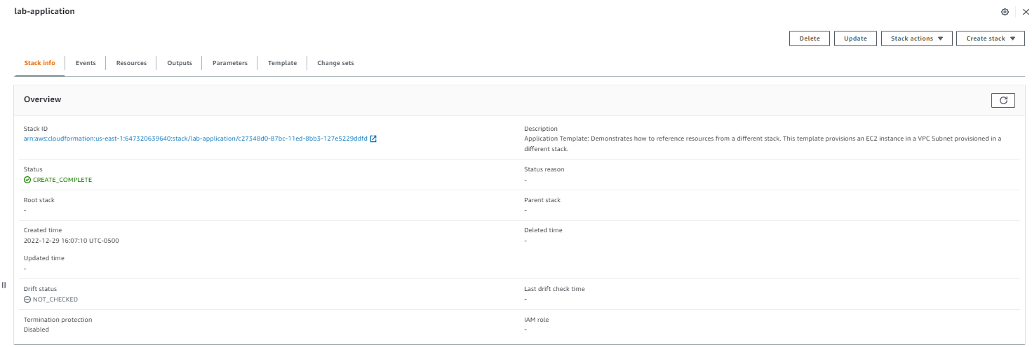
Under stack info wait for the status to change to create_complete

Slide 24
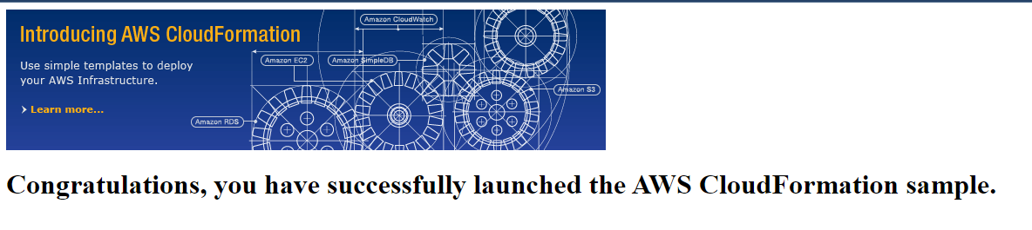
Choose the outputs tab and copy the url that is present in a browser

Slide 25
Task 3 : Updating a Stack

Slide 26
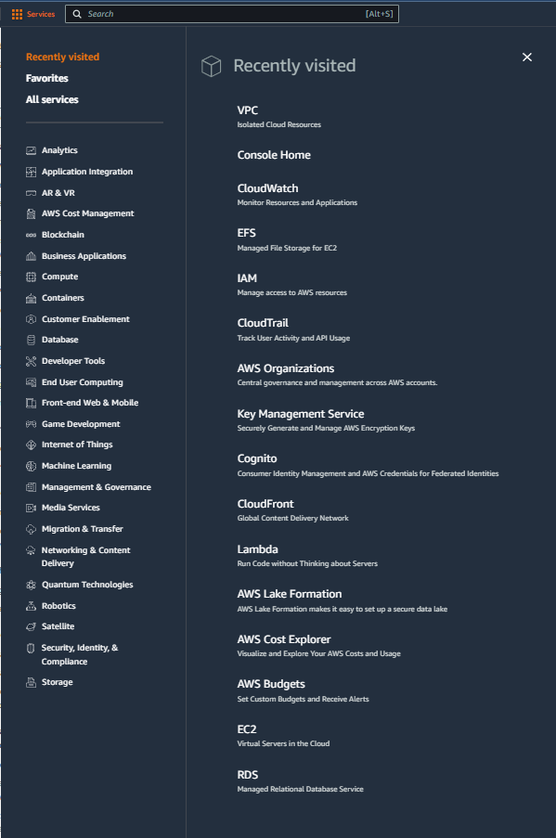
Select services and then click on EC2 button
Click on the Services button
Click on the EC2 button

Slide 27
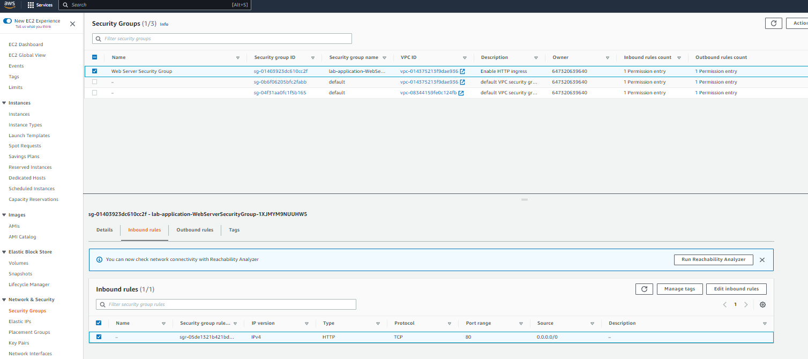
In ec2 choose security groups in the left navigation pane, select security group name - lab-application-WebServerSecurityGroup and go to inbound rules tab to view the inbound rules

Slide 28
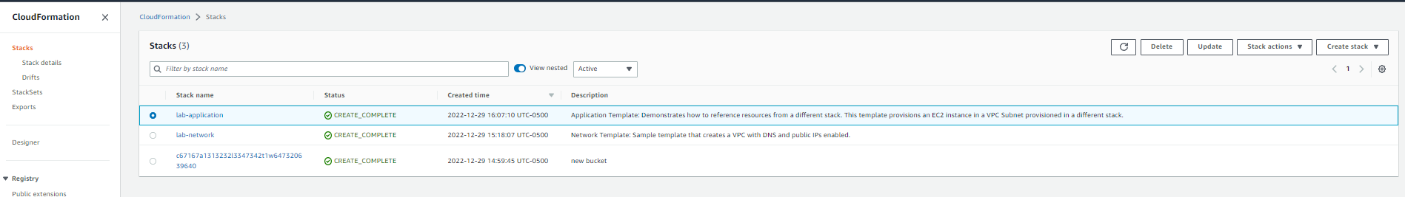
Download lab-application2.yaml file from the aws labs and then switch to cloudformation from services in the aws console, select lab-application stack and choose update

Slide 29
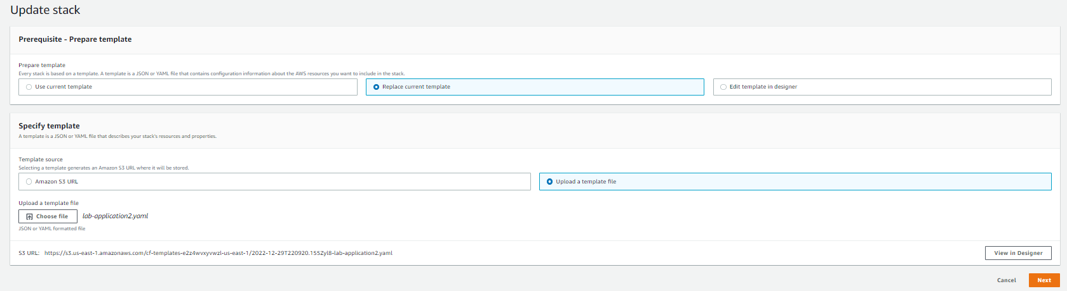
Choose replace current template > upload a template file and upload the lab-application2.yaml file and click next for the next 3 screens

Slide 30
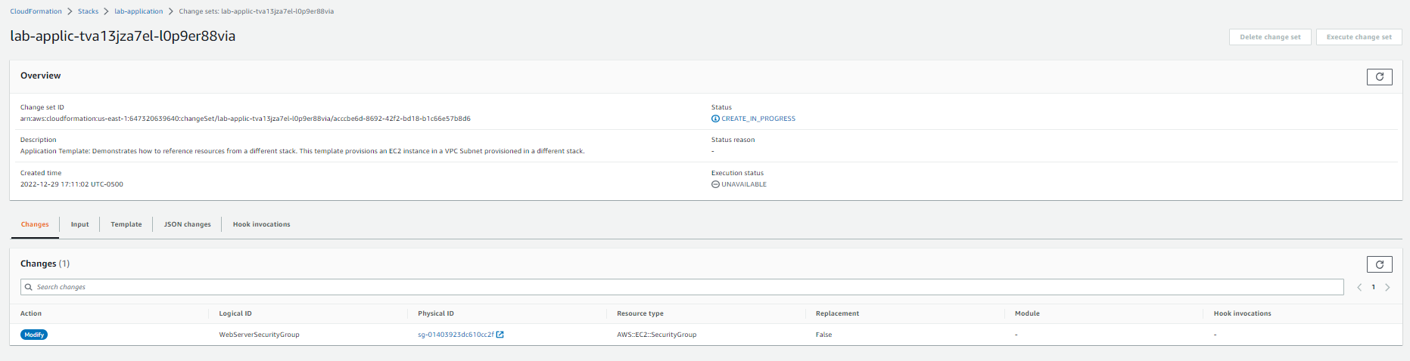
Click on view changeset in the review screen to preview the changes

Slide 31
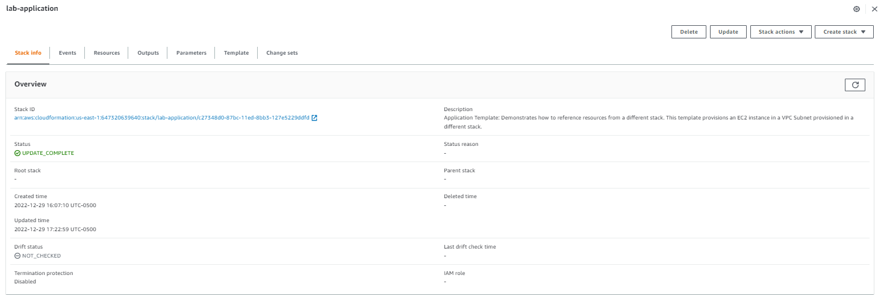
Click on submit to update the dataset and then wait for the stack info tab to change the status to update complete

Slide 32
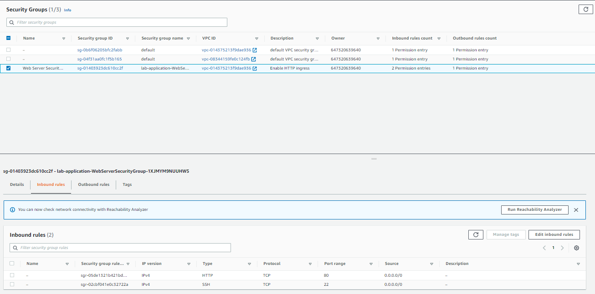
Return to the security groups tab and select the lab application security group you can see an additional ssh tcp rule is added

Slide 33
Task 4 : Exploring templates with AWS CloudFormation Designer

Slide 34
Select services and then click on Cloudformation button
Click on the Services button
Click on the CloudFormation button

Slide 35
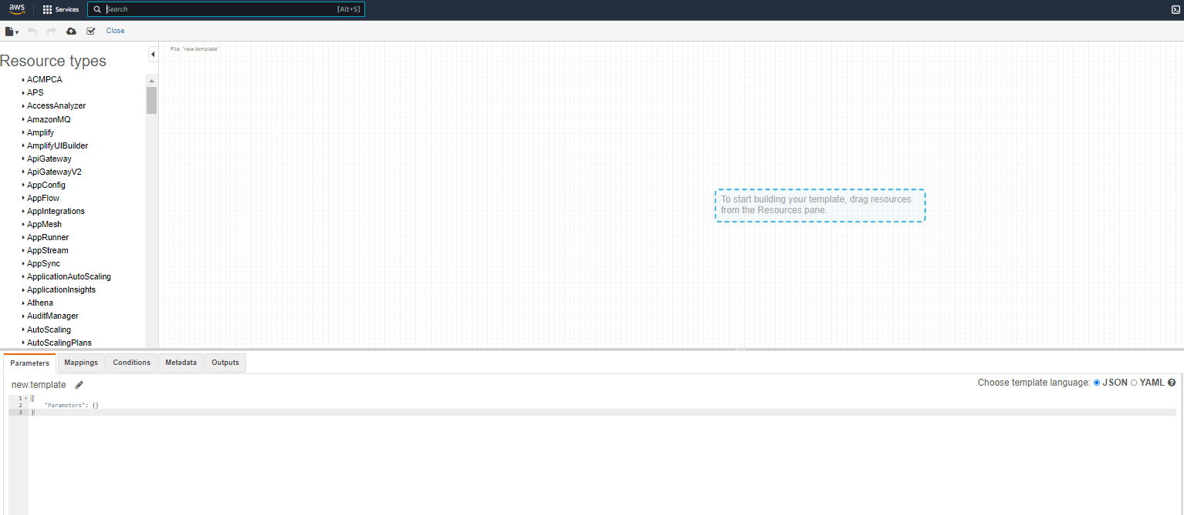
Choose designer in the left navigation pane

Slide 36
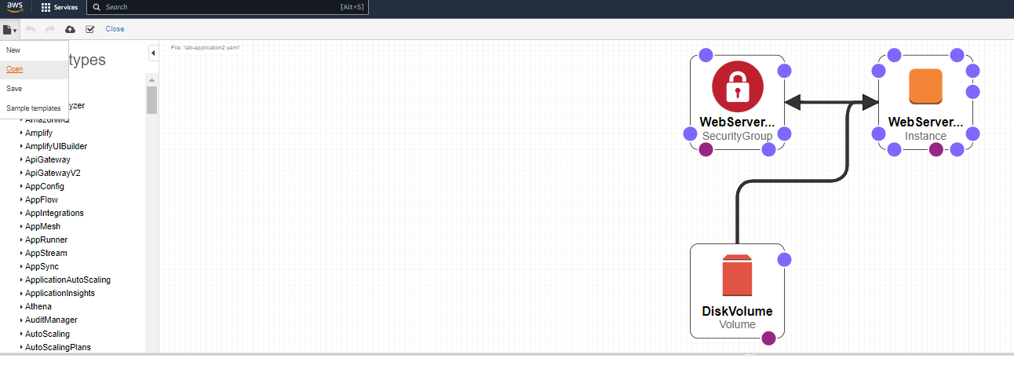
click on file > open > local file > lab-application2.yaml

Slide 37
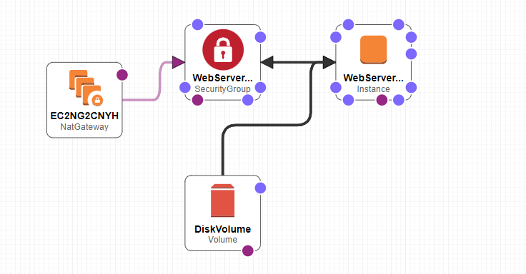
Experiment with the designer by analyzing the various components (optional)

Slide 38
Task 5 : Deleting the stack

Slide 39
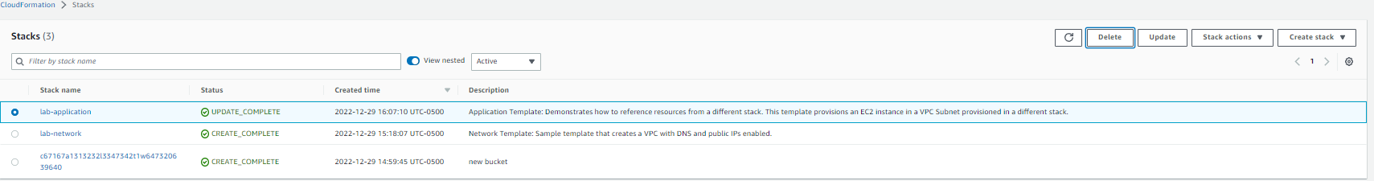
In aws cloudformation choose lab-application and click on delete and then delete stack

Slide 40
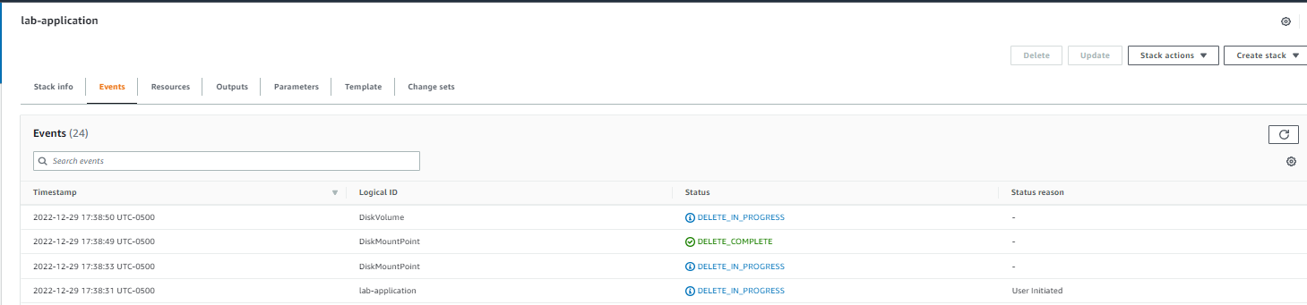
You can monitor the stack deletion by clicking on lab-application and switching on events to see the deletion in progress

Slide 41
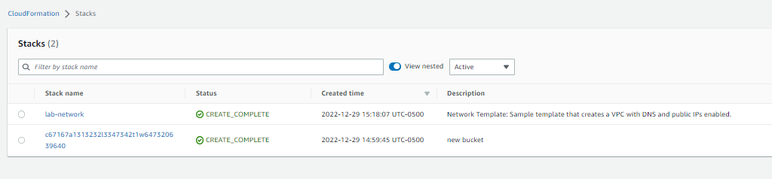
Once the stack is deleted it is removed from the available options in stacks

Slide 42
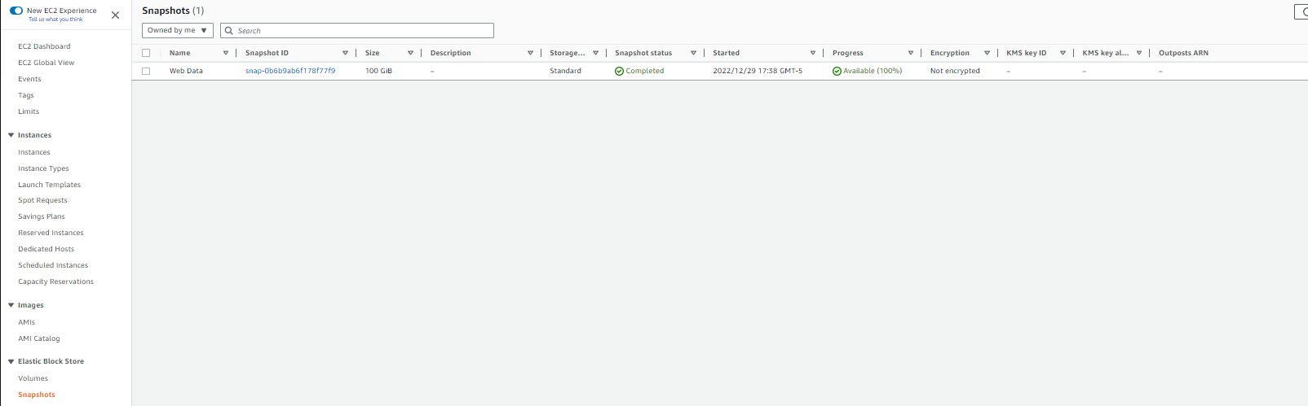
In ec2 services under snapshot you can see that a snapshot was created for the EBS volume

Slide 43
THANK YOU
Amrit Singh

